Slide 1

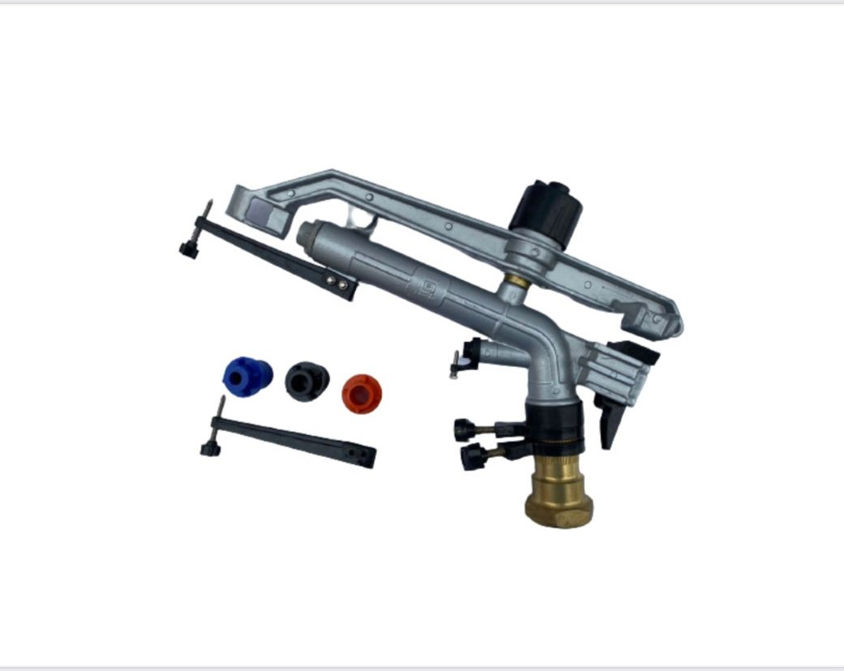
Metal Raingun 1.5” Jaguar
Material | Metal Cast Body
Nozzles | 5.1mm & 12, 14, 16,18mm
Attachment Thread Size | 1.5 Inch Female
Coverage | Diameter 40 – 68 Meter
Flow Rate | 150 – 485 Liter/Min
Pressure | 2-5 Kg/Sq Cm
Packing Size | 47 x 29 x 11.5 Cm
Weight | 3.3 Kg

Slide 2
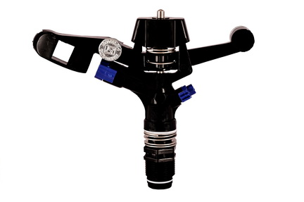
Three-fourth Inch Full Circle Sprinkler (GL 19)
Material | ABS/PP Plastic
Nozzles | 5 mm & 2.5 mm
Attachment Thread Size | 3/4 Inch Male
Coverage | Diameter 13 – 18 Meter
Flow Rate | 7 – 33 Liter/Min
Pressure | 2-5 kg/Sq Cm
Pack Size | 16.5 x 19 x 4.5 cm
Weight | 175 gms

Slide 3
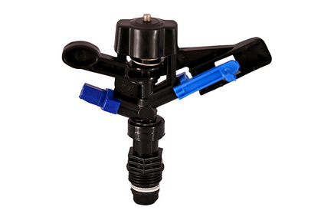
Half Inch Full Circle Sprinkler (GL 35)
Material | ABS/PP Plastic
Nozzles | 3.6 mm & 2.0 mm
Attachment Thread Size | 1/2 Inch Male
Coverage | Diameter 11 – 16 Meter
Flow Rate | 7 – 20 Liter/Min
Pressure | 2-5 kg/Sq Cm
Pack Size | 13 x 13 x 4.5 cm
Weight | 125 gms

Slide 4
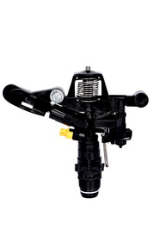
Three-fourth Inch Part Circle Sprinkler (GL S30)
Material | ABS/PP Plastic
Nozzles | 5 mm & 2.5 mm
Attachment Thread Size | 3/4 Inch Male
Coverage | Diameter 13 – 18 Meter
Flow Rate | 11 – 40 Liter/Min
Pressure | 2-5 kg/Sq Cm
Pack Size | 24 x 32 x 64 cm
Half Inch Part Circle Sprinkler (GL 1)
Material | ABS/PP Plastic
Nozzles | 5 mm & 2.5 mm
Attachment Thread Size | 1/2 Inch Male
Coverage | Diameter 10 - 16Meter
Flow Rate | 12 – 28 Liter/Min
Pressure | 2-5 kg/Sq Cm
Pack Size | 11 x 13 x 8 cm

Slide 5
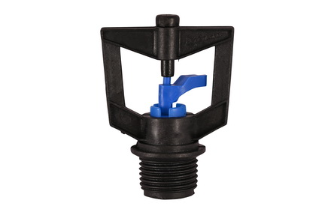
Micro Sprinkler ½” Hook Rotor( GL 91B 180L/H)
Material | Delrin/PPCP Plastic
Nozzles | 1.8 mm/2.8 mm
Attachment Thread Size | 1/2 Inch Male
Coverage | Diameter 7 – 25 ft
Flow Rate | 120 – 180 Liter/Hr
Pressure | 2-5 kg/Sq Cm

Slide 6
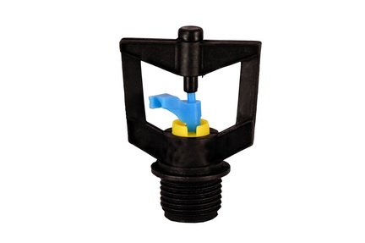
Micro Sprinkler ½” Hook Rotor( GL 91B 120L/H)
Material | Delrin/PPCP Plastic
Nozzles | 1.8 mm/2.8 mm
Attachment Thread Size | 1/2 Inch Male
Coverage | Diameter 7 – 25 ft
Flow Rate | 80 – 120 Liter/Hr
Pressure | 2-5 kg/Sq Cm

Slide 7
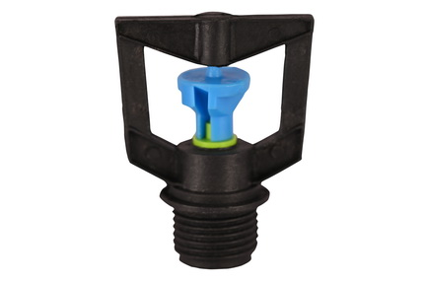
Micro Sprinkler ½” double side Rotor( GL 91A 180L/H)
Material | Delrin/PPCP Plastic
Nozzles | 1.8 mm/2.8 mm
Attachment Thread Size | 1/2 Inch Male
Coverage | Diameter 7 – 25 ft
Flow Rate | 120 – 180 Liter/Hr
Pressure | 2-5 kg/Sq Cm

Slide 8
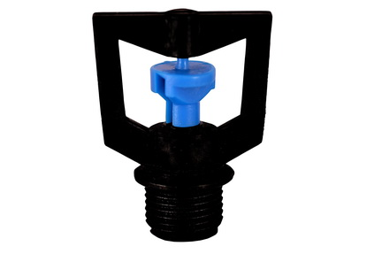
Micro Sprinkler ½” double side Rotor( GL 91 250L/H)
Material | Delrin/PPCP Plastic
Nozzles | 1.8 mm/2.8 mm
Attachment Thread Size | 1/2 Inch Male
Coverage | Diameter 7 – 25 ft
Flow Rate | 120 – 250 Liter/Hr
Pressure | 2-5 kg/Sq Cm

Slide 9
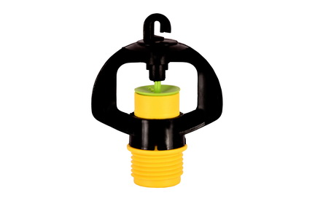
Micro Sprinkler ½” Pop-up Rotor
( GL 91C 180 & 250 L/H)
Material | Delrin/PPCP Plastic
Nozzles | 1.8 mm/2.8 mm
Attachment Thread Size | 1/2 Inch Male
Coverage | Diameter 7 – 25 ft
Flow Rate | 120 – 250 Liter/Hr
Pressure | 2-5 kg/Sq Cm

Slide 10
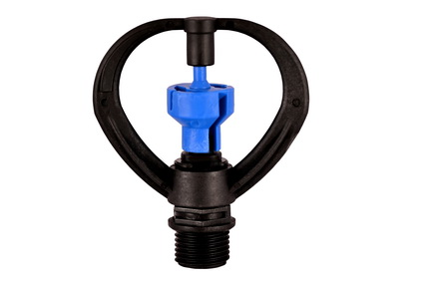
Butterfly Sprinkler ½”
Material | Delrin/PPCP Plastic
Nozzles | 3.6 mm
Attachment Thread Size | 1/2 Inch Male
Coverage | Diameter 12-30 ft
Flow Rate | 250 – 350 Liter/Hr
Pressure | 2-5 kg/Sq Cm
Pack Size | 1 25.5 x 23 x 10.5 cm
Weight | 820 gms

